Slide 1
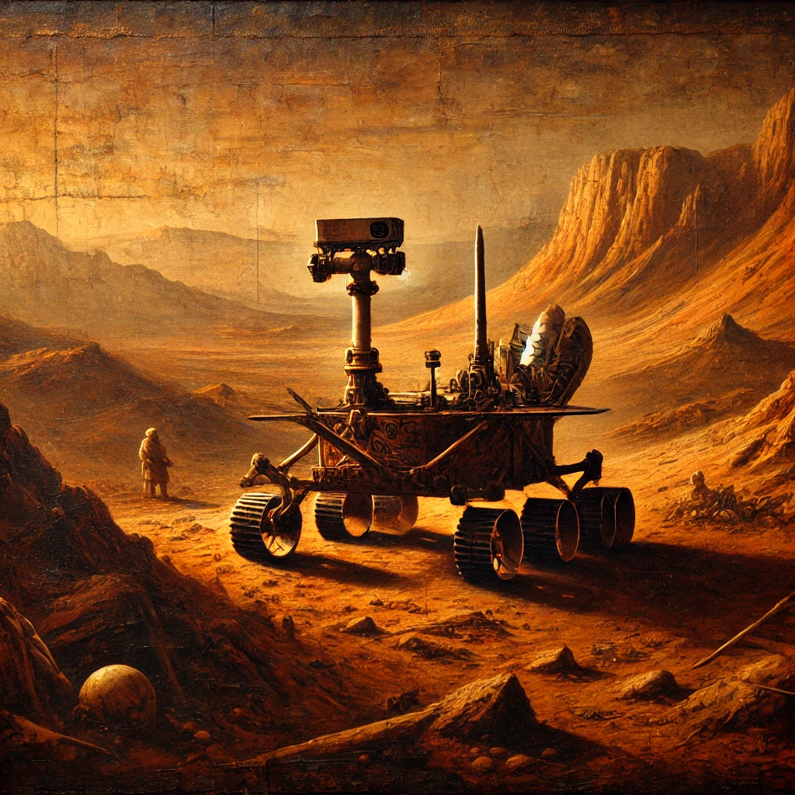
Simple stupid Rover
Thomas, Robbe, Adam

Slide 2
S.S.R.
As humanities interest in Mars grows, an understanding of its weather is needed. One of the greatest challenges that the planet provides are the frequent dust storms.
This project will try to monitor the weather phenomenon (such as temperature, humidity, light, ...) to predict such storms.
(so good! I think we can say that !!!)
Notes:
Tom

Slide 3
The vision of mars rover
power efficient to last long on harvested energy
low power communication including BLE & LoRa
Environment measurements (°C, RH, LUX)
Tilt detection (gyro)
energy awareness is an important key stone of our system as it relies on harvested energy.
Notes:
Tom

Slide 4
MVP
The MVP (Minimal Vital Product) contains the following items:
- LoRa module connection that transmits data.
- Dashboard to review received data.
- The ability to measure temperature and humidity.
- Only measure when there is enough energy available.
Notes:
Adam

Slide 5
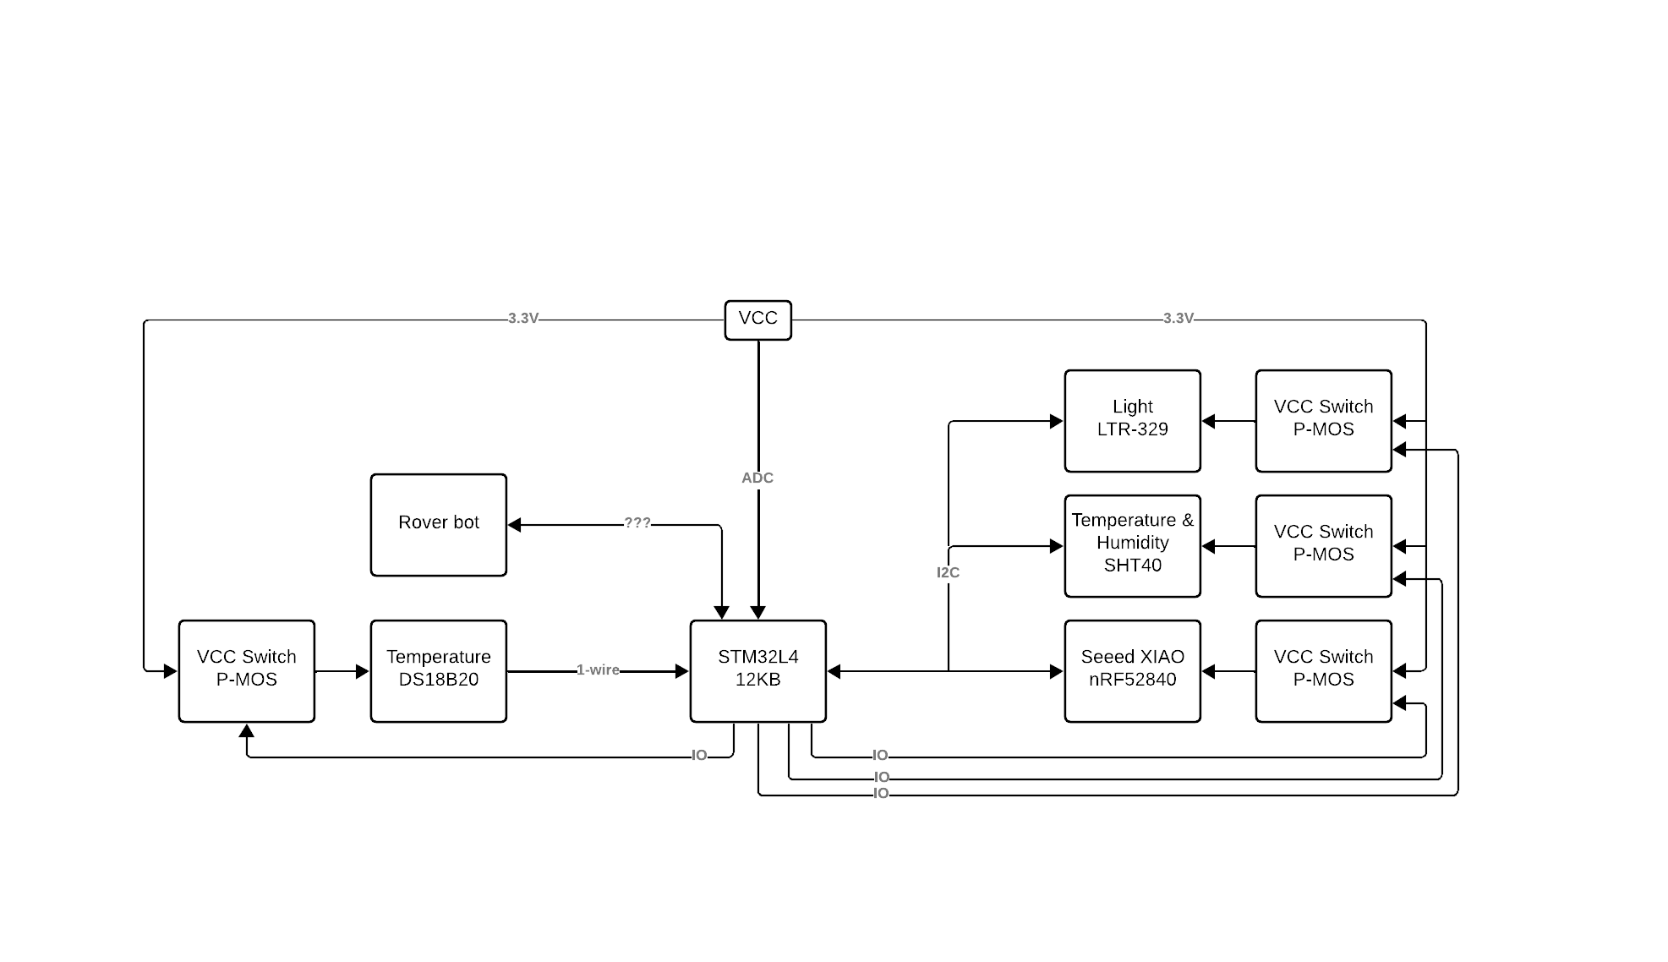
Notes:
Robbe

Slide 6
Team Division
Adam
enviromental sensing
Energy output managment
Robbe
BLE
Energy Profiling
Thomas
Gyroscope
LoRa
Dashboard
Notes:
Adam

Slide 7
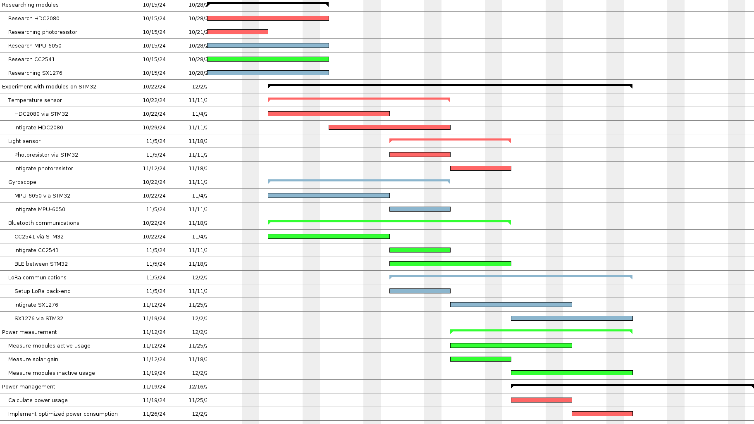
Notes:
Adam

Slide 8
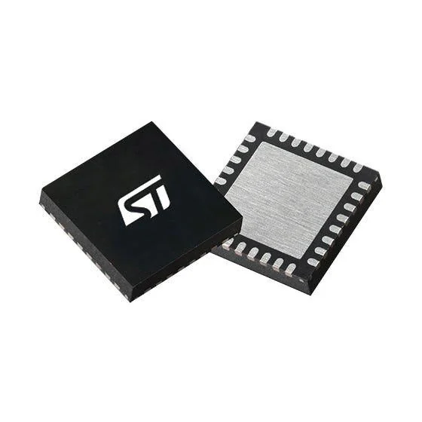
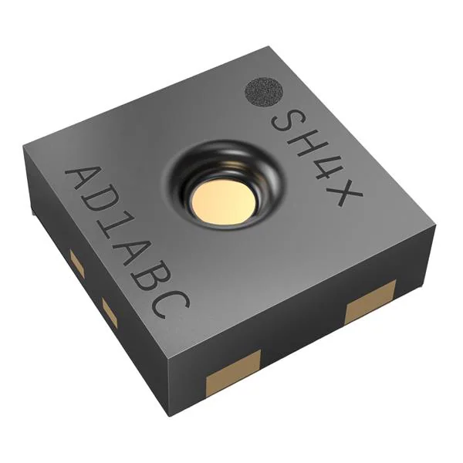
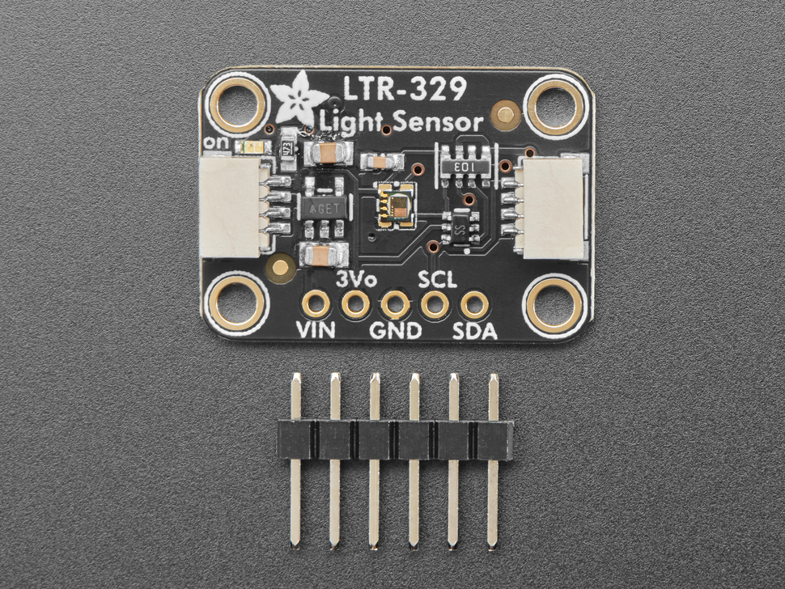
Sensing
asd
Notes:
Adam

Slide 9
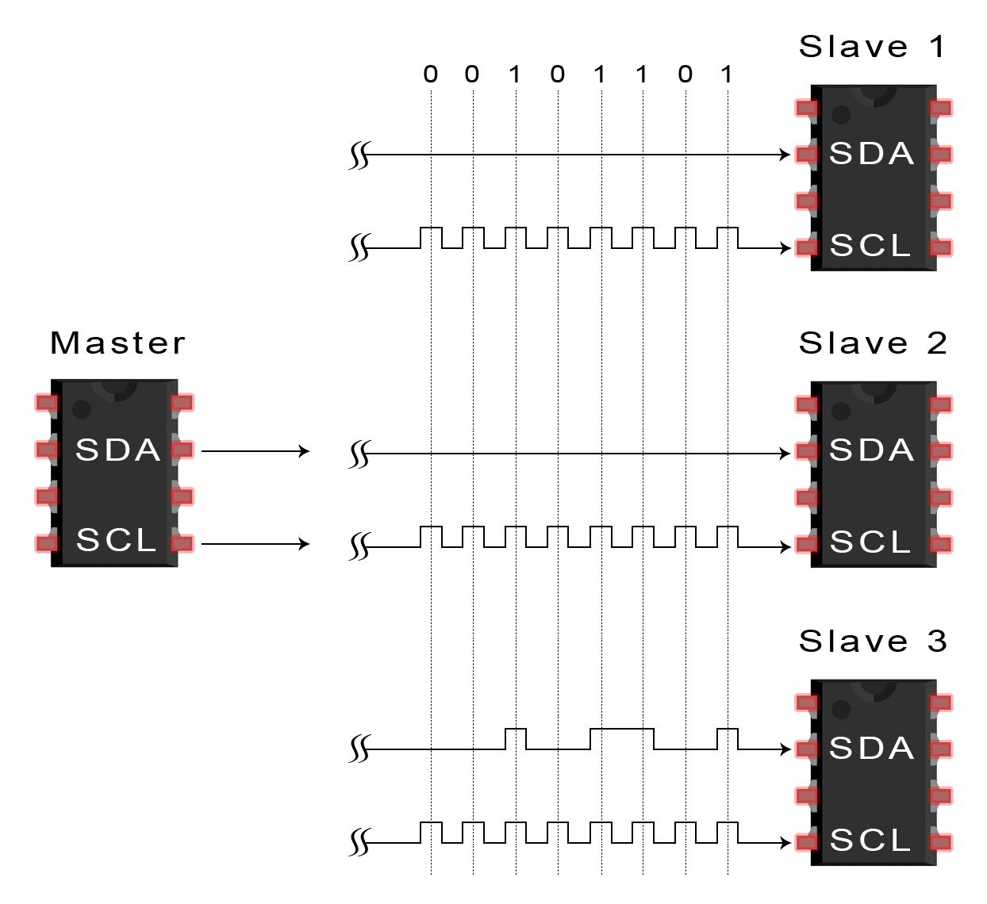
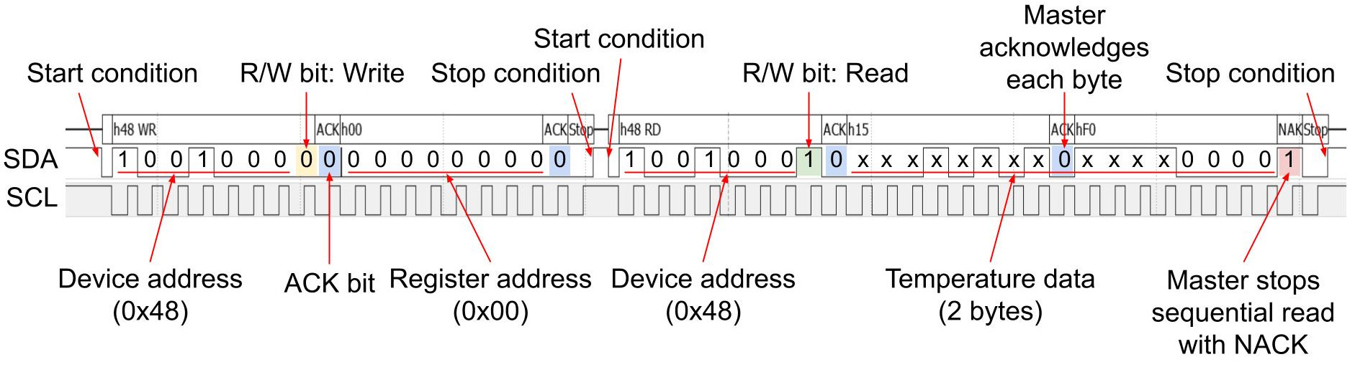
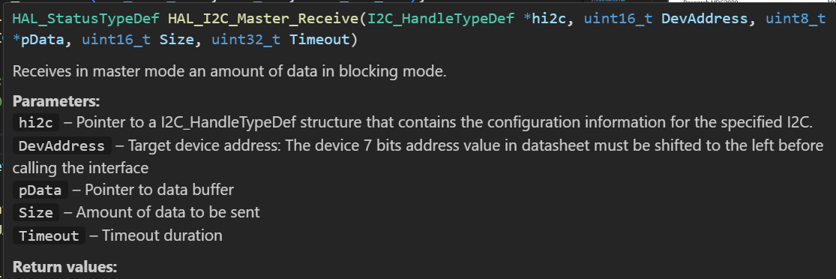
I2C
Overall i would probably just talk about the ideal way of sensing and how it should be done,
Then i would like mention that its my firs time doind I2C communication and then i could show my code that will hopefully whork by then.
I could also mention the photo resistor idea
Notes:
Adam

Slide 10
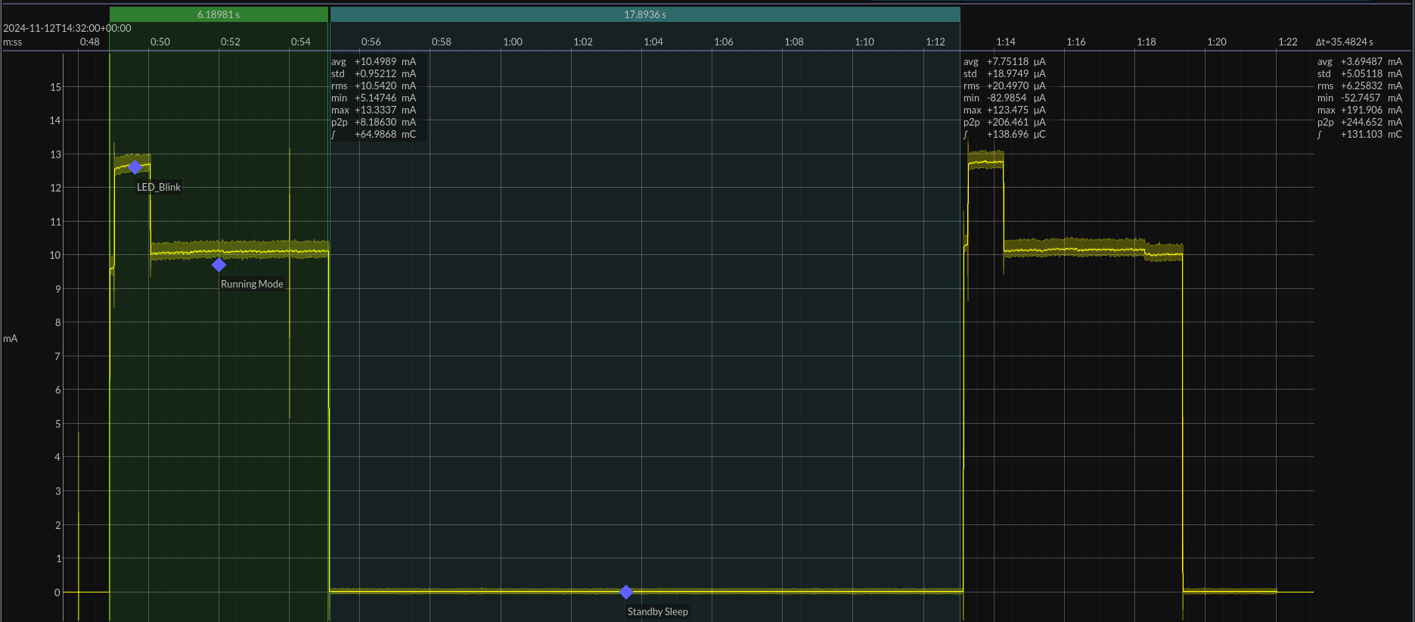
Energy profiling STM32
Notes:
Robbe

Slide 11
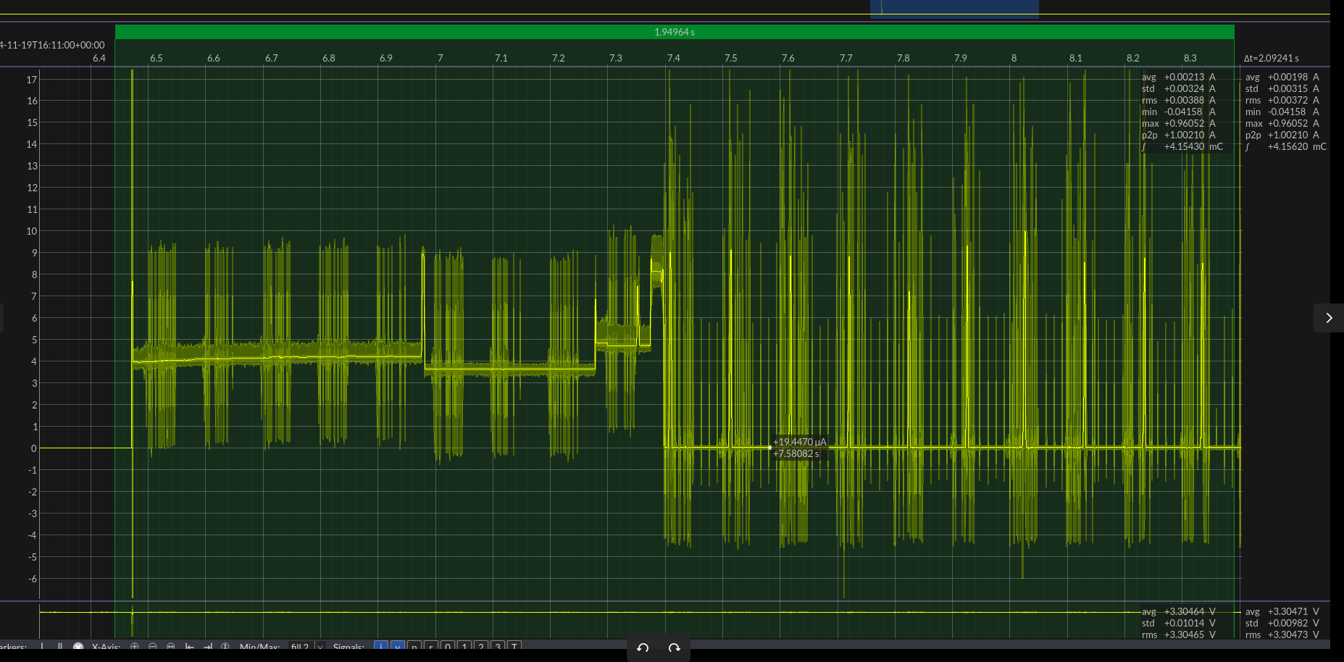
Energy profiling BLE beacon
Notes:
Robbe

Slide 12
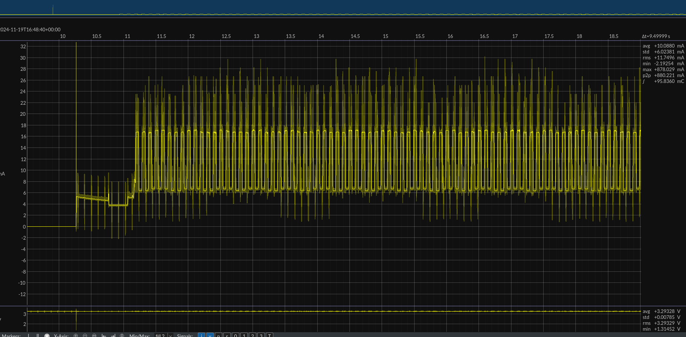
Energy profiling BLE Scan
Notes:
Robbe

Slide 13
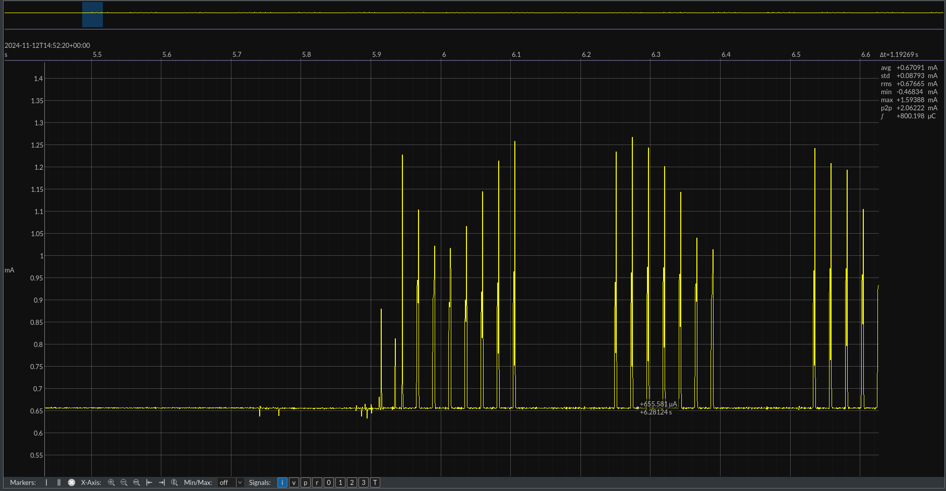
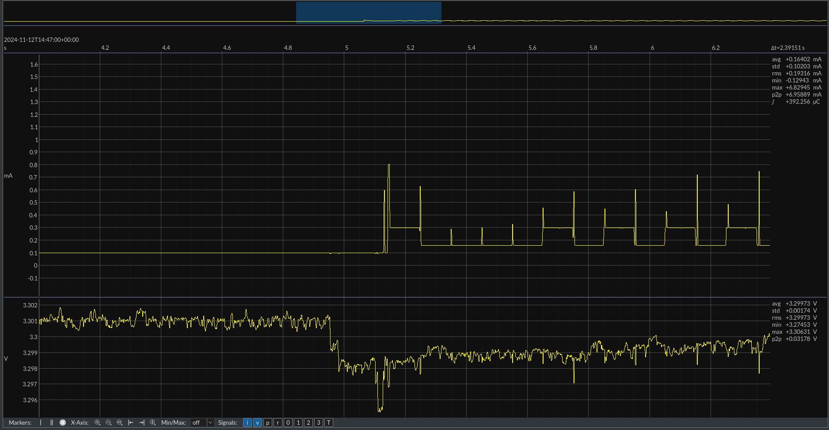
Energy profiling Environment
SHT40
LTR-329
Notes:
Robbe

Slide 14
Energy profiling
Module Average
Stm32 2.7mA
BLE 3mA OR 10mA
SHT40 0.67mA
LTR-329 0.23mA
LoRa …
Total 6.6mA OR 13.6mA
Notes:
Robbe

Slide 15

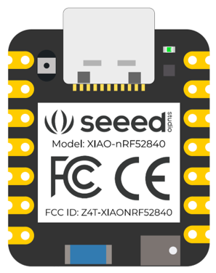

BLE comm
SSR 1
SSR 2
beacon
scan
Notes:
Robbe

Slide 16
Lorawan ith moderated nodered server !!!
Notes:
Tom

Slide 17
Gyroscope IMU
Notes:
Tom

Slide 18
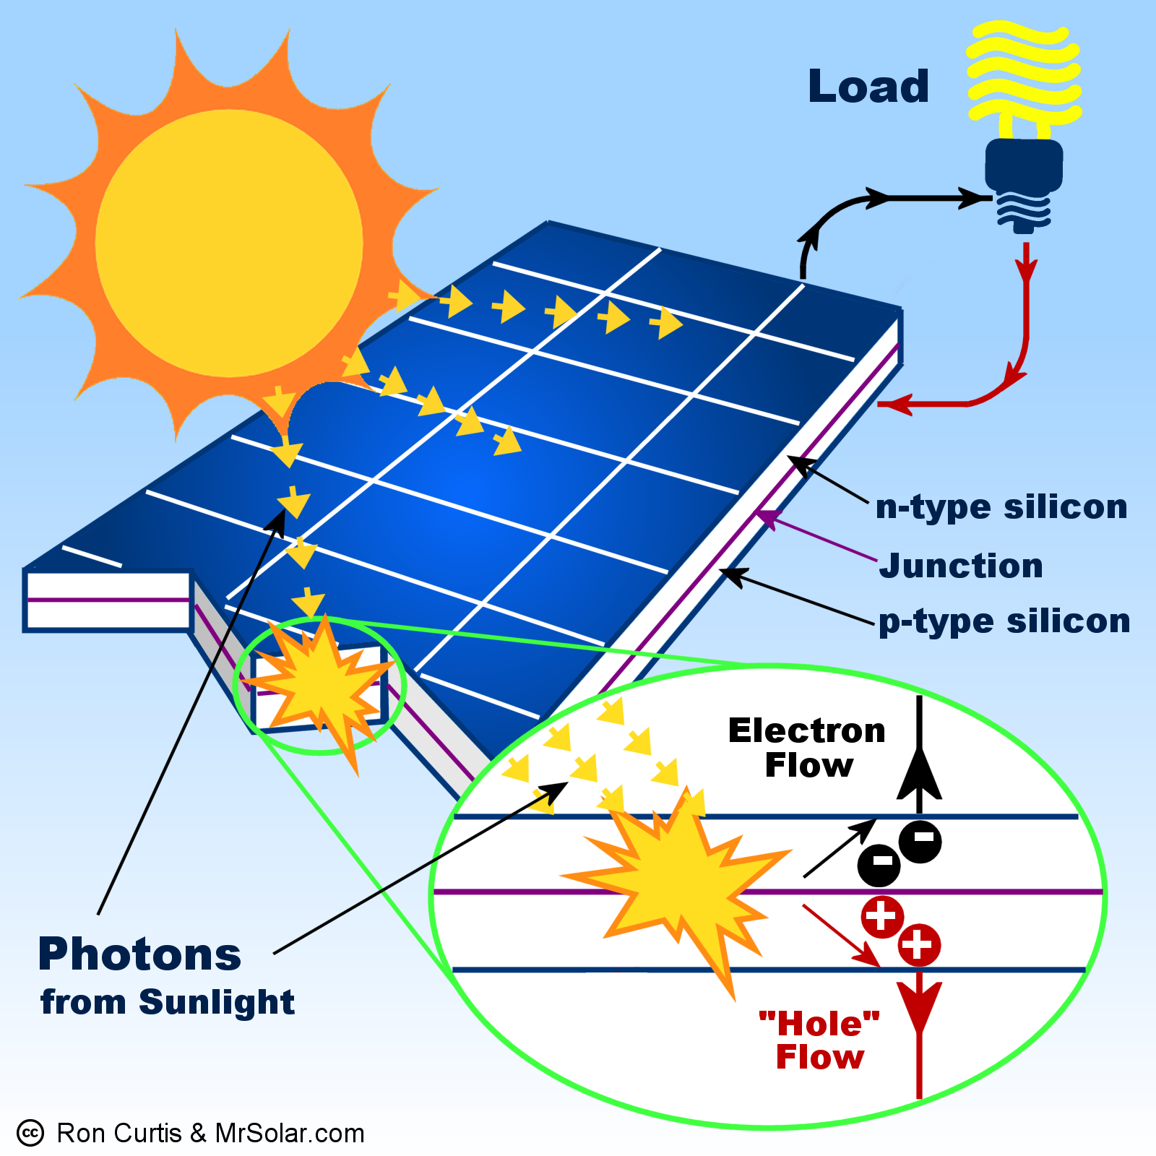
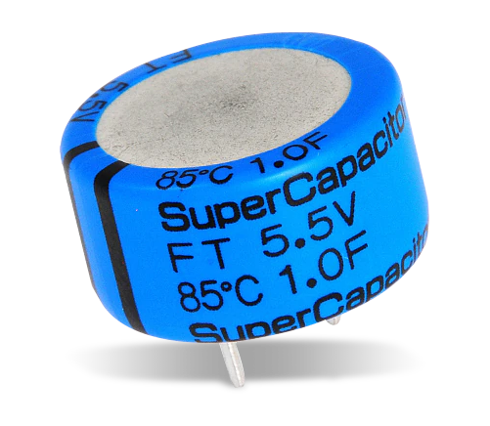
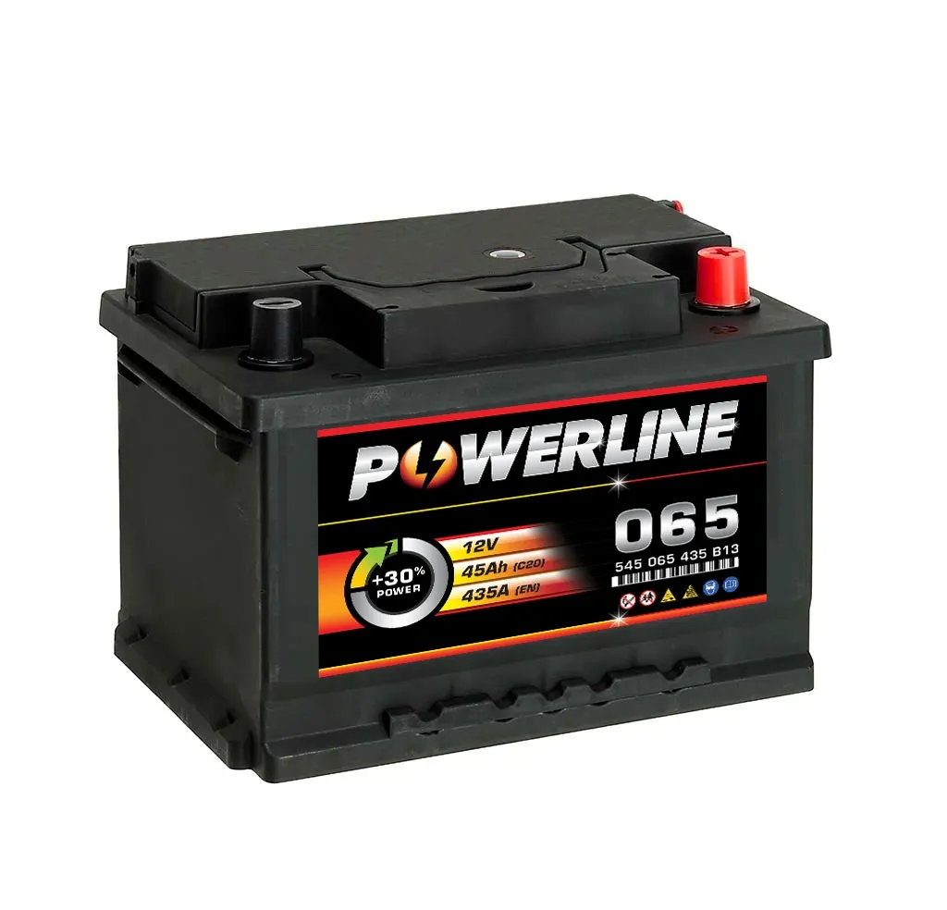
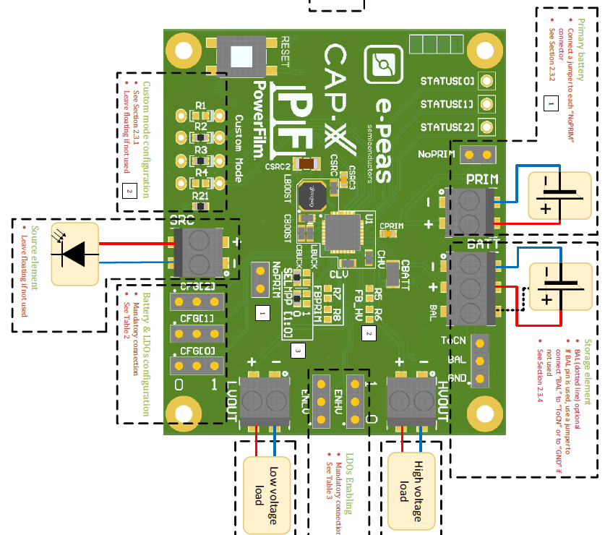
Enegry output managmenT
Notes:
Adam

Slide 19


Energy harvesting so far and expectations
From the HighVoltage output we would power the STM32 together with our enviromental measuring units.
1,8V vs 3.3V

Slide 20
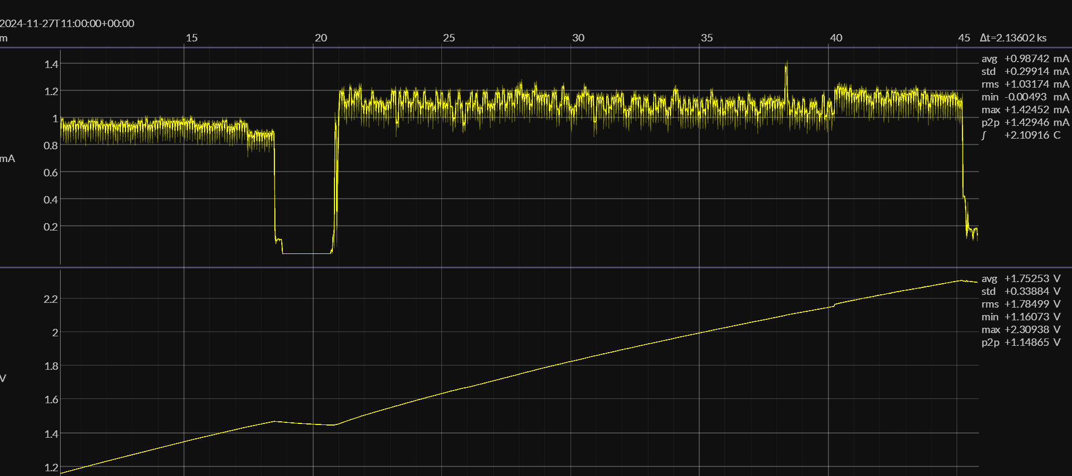

Slide 21
We have:- Outside S.P.- Inside S.P.- 2x 2,7V1F Supercap- 2x AEM10941 Evaluation Kit Note to self: Make sure to have SuperCap connected before connecting power source (S.P.)Tested Single Cell Configuration: It seems to be ok on 2,7V treshhold, the module gets slighty over 2,7 Volts and than regulates it down so that the Capacitor is okay. HighOUT: 1,8VLowOUT? 1,2Vaccording to datasheetIt takes about 1h 35m to charge the Cap. to 2,3V WITH additional artiffical lights

